Slide 1
CSE470: Software Engineering
Factory Pattern
Head First Design Pattern Page: 147 (107) - 167 (129)

Slide 2
Factory Method Pattern
Defines an interface for creating an object, but lets subclasses decide which class to instantiate.
Factory pattern is used to create object without exposing the instantiation logic to the client.
Factory Method lets a class defer instantiation to its subclasses.
Also known as the Virtual Constructor.

Slide 3
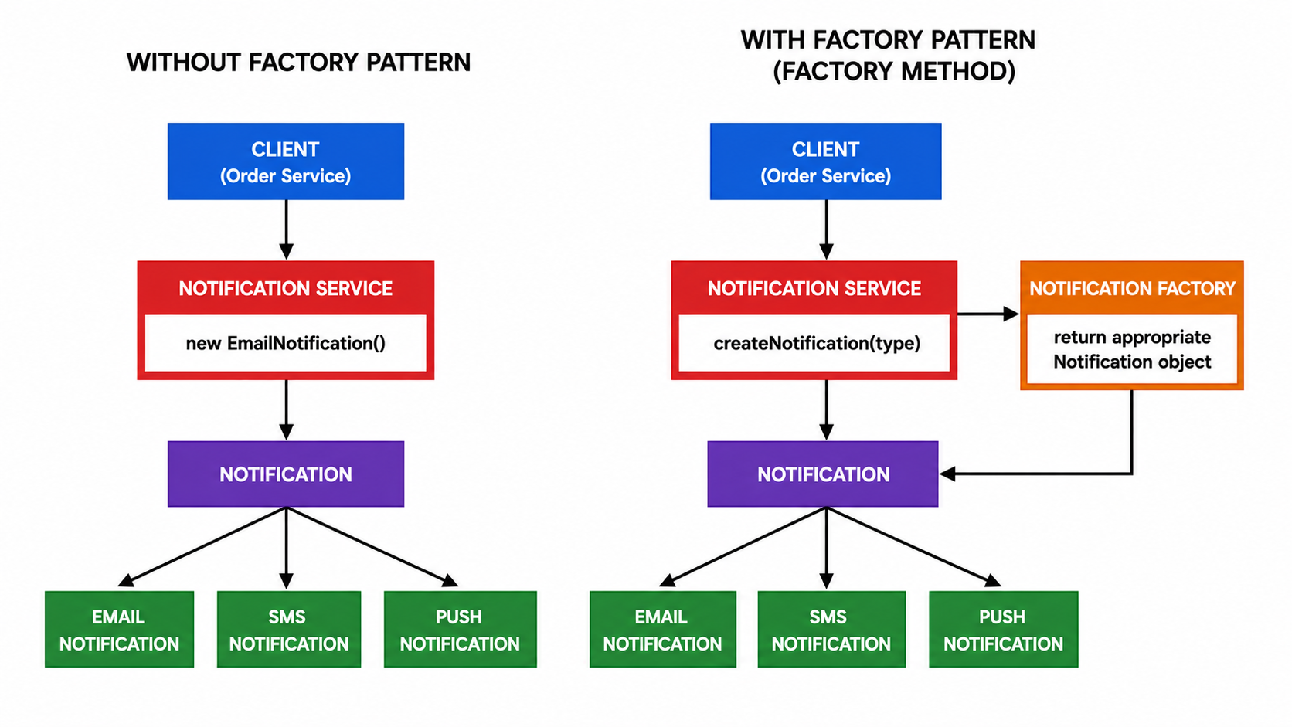
Without Design Pattern - Example

Slide 4
Without Design Pattern - Implementation
public abstract class Document {
public abstract void open();
}
public class DrawingDocument extends Document {
public void open() {/* ... */}
}
public class TextDocument extends Document {
public void open() {/* ... */}
}
public class Application {
public void newDocument() {
// Document is abstract - cannot instantiate
// Hard-coding a subclass locks us in.
// violates DRY Principle.
Document doc = new DrawingDocument();
doc.open();
}
}
Application knows WHEN a document should be created, not WHAT KIND. Hard-coding the subclass is not a scalable solution.

Slide 5
Factory Method Pattern - Example

Slide 6
Factory Method Pattern Example

Slide 7
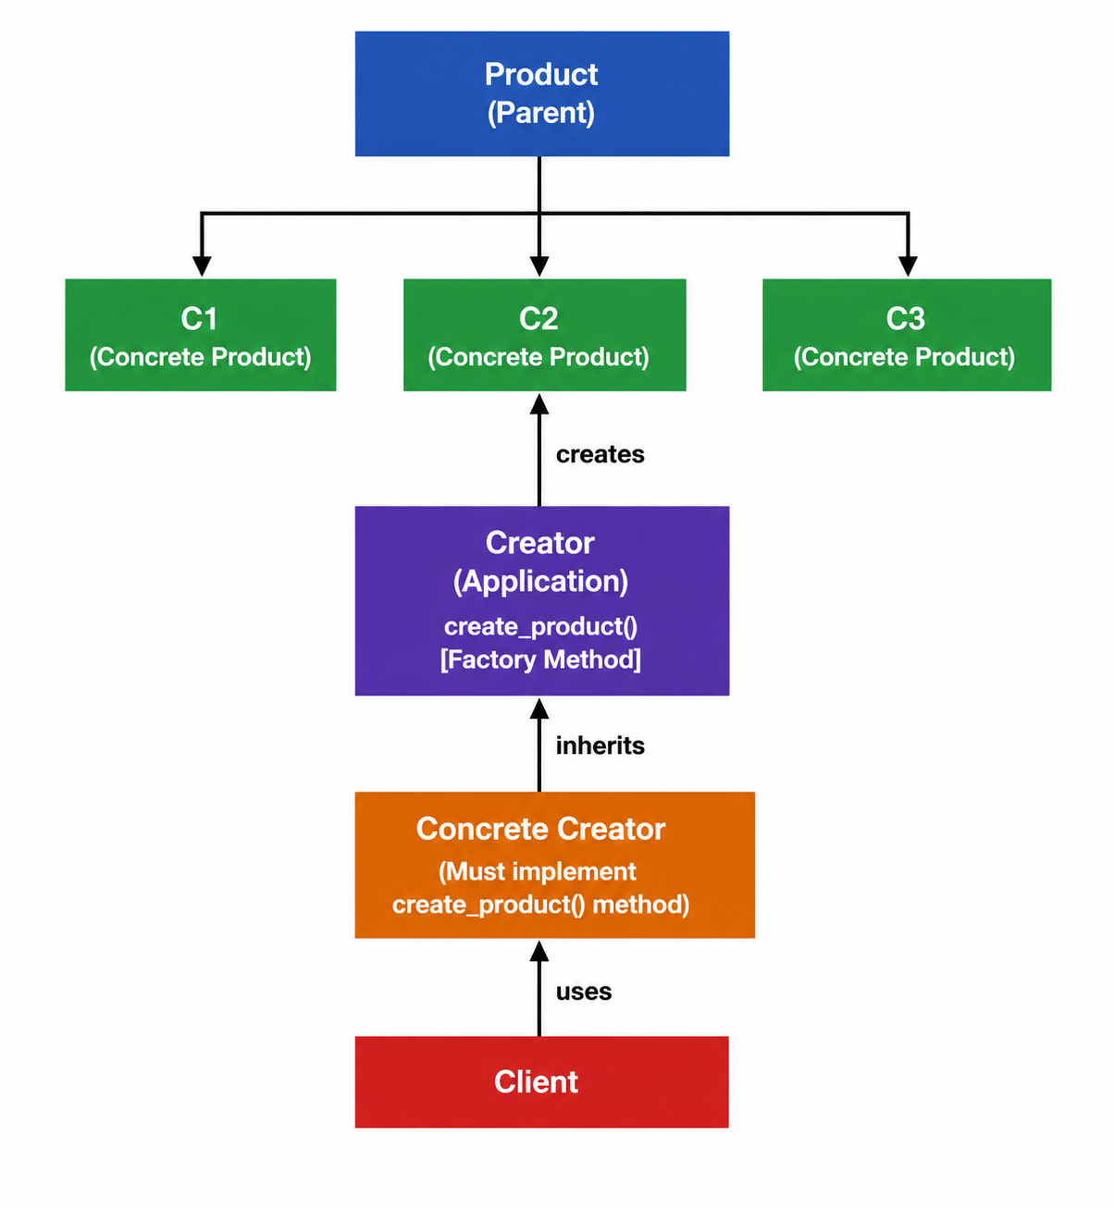
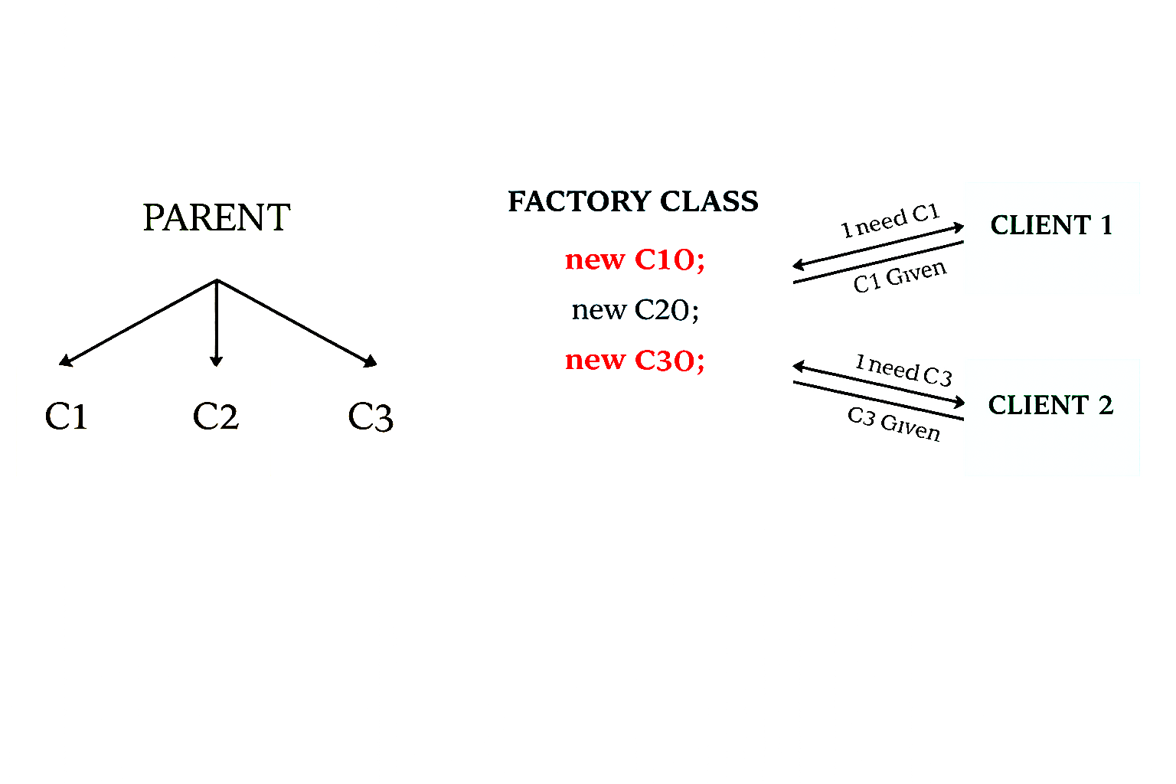
Factory Method Pattern Structure
Abstract Factory method: create_product()
Implements Factory method: create_product()

Slide 8
Factory Method Pattern
Definition: The Factory Method Pattern defines an interface for creating an object, but lets subclasses decide which class to instantiate.
Motivation:
A class cannot anticipate the class of objects it must create (e.g., a framework only knows abstract classes).
A class wants its subclasses to specify the objects it creates.
Classes delegate responsibility to one of several helper subclasses, and we want to localize the knowledge of which helper is the delegate.

Slide 9
Factory Method Pattern
Participants:
Product (e.g., Document)
– Defines the interface of the objects the factory method creates.
ConcreteProduct (e.g., MyDocument)
– Implements the Product interface.
Creator (e.g., Application)
– Declares the factory method, which returns an object of type Product. May call the factory method to create a Product object.
ConcreteCreator (e.g., MyApplication)
– Overrides the factory method to return an instance of a ConcreteProduct.

Slide 10
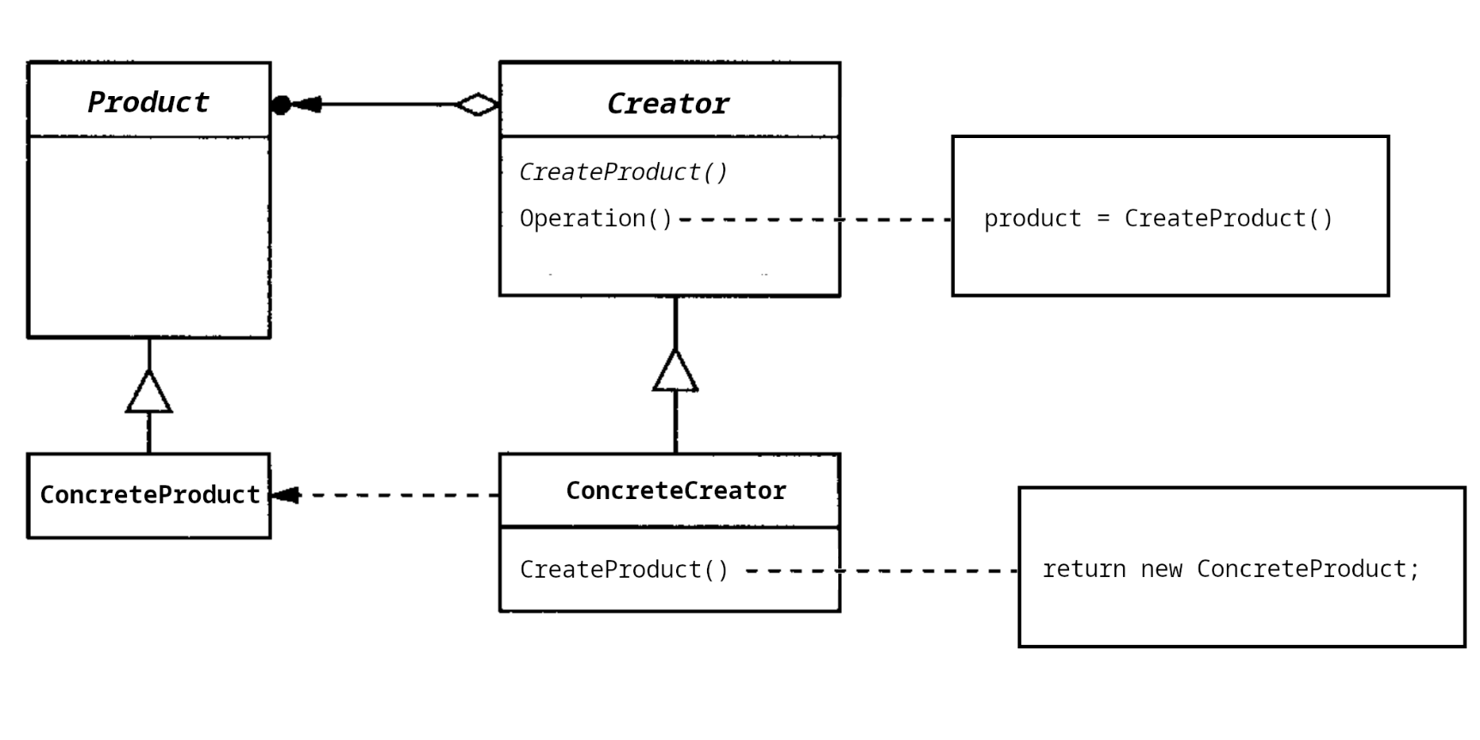
Factory Method Pattern - Structure

Slide 11
Factory Method Pattern - Structure (Python)
from abc import ABC, abstractmethod
class Product(ABC):
@abstractmethod
def operation(self): pass
class ConcreteProduct(Product):
def operation(self):
print("ConcreteProduct operation")
class Creator(ABC):
@abstractmethod
def create_product(self): pass # the factory method
def operation(self):
product = self.create_product()
product.operation()
class ConcreteCreator(Creator):
def create_product(self):
return ConcreteProduct()

Slide 12
Factory Method Pattern - Structure (Python)
if __name__ == "__main__":
# Client code works through the Creator interface;
# the concrete subclass decides which Product is built.
creator = ConcreteCreator()
creator.operation()

Slide 13
Factory Method Pattern - Structure (Python)
OUTPUT=>
ConcreteProduct operation

Slide 14
Factory Method Pattern - Example (Python)
from abc import ABC, abstractmethod
class Document(ABC):
@abstractmethod
def open(self): pass
class DrawingDocument(Document):
def open(self): print("Opening drawing document")
class TextDocument(Document):
def open(self): print("Opening text document")
class Application(ABC):
@abstractmethod
def create_document(self): pass # factory method
def new_document(self):
doc = self.create_document()
doc.open()
class DrawingApplication(Application):
def create_document(self):
return DrawingDocument()

Slide 15
Factory Method Pattern - Example (Python)
if __name__ == "__main__":
app = DrawingApplication()
app.new_document()
# Application never referenced DrawingDocument directly.
# Swapping to a TextApplication subclass would change the
# product with no edits inside Application.new_document.

Slide 16
Factory Method Pattern - Structure (Java)
public abstract class Product {
public abstract void operation();
}
public class ConcreteProduct extends Product {
public void operation() {
System.out.println("ConcreteProduct operation");
}
}
public abstract class Creator {
public abstract Product createProduct(); // factory method
public void operation() {
Product p = createProduct();
p.operation();
}
}
public class ConcreteCreator extends Creator {
public Product createProduct() {
return new ConcreteProduct();
}
}

Slide 17
Factory Method Pattern - Structure (Java)
Creator creator = new ConcreteCreator();
creator.operation();

Slide 18
Factory Method Pattern - Example (Java)
public abstract class Document {
public abstract void open();
}
public class DrawingDocument extends Document {
public void open() { /* ... */ }
}
public abstract class Application {
public abstract Document createDocument(); // factory method
public void newDocument() {
Document doc = createDocument();
doc.open();
}
}
public class DrawingApplication extends Application {
public Document createDocument() {
return new DrawingDocument();
}
}

Slide 19
Factory Method Pattern - Example (Java)
public class Main {
public static void main(String[] args) {
Application app = new DrawingApplication();
app.newDocument();
}
}

Slide 20
Thank You

Slide 21
Factory Method Pattern
Defines an interface for creating an object, but lets subclasses decide which class to instantiate.
Factory pattern is used to create object without exposing the instantiation logic to the client.
Factory Method lets a class defer instantiation to its subclasses.
Also known as the Virtual Constructor.

Slide 22
Factory Method Pattern

Slide 23
Factory Method Pattern - Example
public abstract class Notification {
public abstract void open();
}
public class Email extends Notification {
public void send() {/* ... */}
}
public class SMS extends Notification {
public void send() {/* ... */}
}
public class Application {
public void newNotification() {
// Notification is abstract - cannot instantiate
// Hard-coding a subclass locks us in.
Notification notification = new Email();
notification.send();
}
}
Application knows WHEN a document should be created, not WHAT KIND. Hard-coding the subclass is not a scalable solution.

Slide 24
Factory Method Pattern

Slide 25
Factory Method Pattern

Slide 26
Factory Method Pattern
Abstract Factory method: create_product()
Implements Factory method: create_product()

Slide 27
Factory Method Pattern
Intent: Define an interface for creating an object, but let subclasses decide which class to instantiate.
Motivation:
A class cannot anticipate the class of objects it must create (e.g., a framework only knows abstract classes).
A class wants its subclasses to specify the objects it creates.
Classes delegate responsibility to one of several helper subclasses, and we want to localize the knowledge of which helper is the delegate.

Slide 28
Factory Method Pattern
Participants:
Product (e.g., Document)
– Defines the interface of the objects the factory method creates.
ConcreteProduct (e.g., MyDocument)
– Implements the Product interface.
Creator (e.g., Application)
– Declares the factory method, which returns an object of type Product. May call the factory method to create a Product object.
ConcreteCreator (e.g., MyApplication)
– Overrides the factory method to return an instance of a ConcreteProduct.

Slide 29
Factory Method Pattern - Structure

Slide 30
Factory Method Pattern - Structure (Python)
from abc import ABC, abstractmethod
class Product(ABC):
@abstractmethod
def operation(self): pass
class ConcreteProduct(Product):
def operation(self):
print("ConcreteProduct operation")
class Creator(ABC):
@abstractmethod
def create_product(self): pass # the factory method
def operation(self):
product = self.create_product()
product.operation()
class ConcreteCreator(Creator):
def create_product(self):
return ConcreteProduct()

Slide 31
Factory Method Pattern - Structure (Python)
if __name__ == "__main__":
# Client code works through the Creator interface;
# the concrete subclass decides which Product is built.
creator = ConcreteCreator()
creator.operation()

Slide 32
Factory Method Pattern - Example
public abstract class Document {
public abstract void open();
}
public class DrawingDocument extends Document {
public void open() {/* ... */}
}
public class TextDocument extends Document {
public void open() {/* ... */}
}
public class Application {
public void newDocument() {
// Document is abstract - cannot instantiate
// Hard-coding a subclass locks us in.
Document doc = new DrawingDocument();
doc.open();
}
}
// violates DRY Principle.
Application knows WHEN a document should be created, not WHAT KIND. Hard-coding the subclass is not a scalable solution.

Slide 33
Factory Method Pattern - Structure (Python)
OUTPUT=>
ConcreteProduct operation

Slide 34
Factory Method Pattern - Example (Python)
from abc import ABC, abstractmethod
class Document(ABC):
@abstractmethod
def open(self): pass
class DrawingDocument(Document):
def open(self): print("Opening drawing document")
class TextDocument(Document):
def open(self): print("Opening text document")
class Application(ABC):
@abstractmethod
def create_document(self): pass # factory method
def new_document(self):
doc = self.create_document()
doc.open()
class DrawingApplication(Application):
def create_document(self):
return DrawingDocument()

Slide 35
Factory Method Pattern - Example (Python)
if __name__ == "__main__":
app = DrawingApplication()
app.new_document()
# Application never referenced DrawingDocument directly.
# Swapping to a TextApplication subclass would change the
# product with no edits inside Application.new_document.

Slide 36
Factory Method Pattern - Structure (Java)
public abstract class Product {
public abstract void operation();
}
public class ConcreteProduct extends Product {
public void operation() {
System.out.println("ConcreteProduct operation");
}
}
public abstract class Creator {
public abstract Product createProduct(); // factory method
public void operation() {
Product p = createProduct();
p.operation();
}
}
public class ConcreteCreator extends Creator {
public Product createProduct() {
return new ConcreteProduct();
}
}

Slide 37
Factory Method Pattern - Structure (Java)
Creator creator = new ConcreteCreator();
creator.operation();

Slide 38
Factory Method Pattern - Example (Java)
public abstract class Document {
public abstract void open();
}
public class DrawingDocument extends Document {
public void open() { /* ... */ }
}
public abstract class Application {
public abstract Document createDocument(); // factory method
public void newDocument() {
Document doc = createDocument();
doc.open();
}
}
public class DrawingApplication extends Application {
public Document createDocument() {
return new DrawingDocument();
}
}

Slide 39
Factory Method Pattern - Example (Java)
public class Main {
public static void main(String[] args) {
Application app = new DrawingApplication();
app.newDocument();
}
}

Slide 40
Thank You

